Slide 1
DESIS ASCEND
EDUCARE
BUY IT RIGHT!
Under the guidance of :
Mr. Aniket Rajendra Thakur Sir
Junihers Group Number - 1
Arya BipinKumar Shahi
Nandini Agrawal
Sejal Maheshwari
Shruti Sharma

Slide 2
TABLE OF CONTENTS
01
INTRODUCTION
03
FEATURES
02
MOTIVATION
04
COMPONENTS
Basic Introduction to the project
Includes all the features of the project
Motivation behind working on this project
All the components of the project

Slide 3
05
DESIGN & ARCHITECTURE
07
RESULTS
06
SNIPPETS
08
FUTURE SCOPE
End result of the project
Explained high level design of the game
Output screenshots from the project
Ideas related to further improvement

Slide 4
INTRODUCTION
“Becoming wealthy is like playing Monopoly, the person who manages to accumulate the most assets wins the game!”
Buy It Right is a board game based on the economic concept of monopoly.
Four players move around the board, purchasing, exchanging, and constructing properties for fictitious money.
The ultimate goal of each player is to bankrupt others by draining their bank accounts and obtaining as much property and real estate as possible.

Slide 5
MOTIVATION
Monopoly is the first ever financial game, most of us have played in our life. In our project, we wanted to merge both the aspects of Finance and Technology together.
Monopoly is an engaging that teaches individuals about finance and it’s management, concepts such as asset, mortgage, bankruptcy, etc.
Users learn how to plan ahead of time, bargain with others, and deal with winning and losing circumstances through this game.
Effectively collaborating on a fun project to learn skills and grow together along with applying the knowledge learnt throughout the program.

Slide 6






Tech Stack Used
Github
Netlify
Collaborated on Github repository by making branches and pull requests.
Deployed our project using Netlify.
Explored the possibility to make it a multi device game but in the interest of time we have this version and can further extend its scope.

Slide 7
Features
Game Modules
UI
Game board consisting of the property spaces and all the various cards.
Buying Properties, Mortgaging Properties, paying mortgage,
paying tax,
rolling dice,
bidding in auction,
building property,
paying rent.
Game Components
Bank Management
Players, Houses, Hotels, Places, Bank, Jail and Chance cards.
Central Bank Management that manages auctioning of properties and overseas transactions.
Transaction Management
Transaction and Move tracking of all the players.

Slide 8
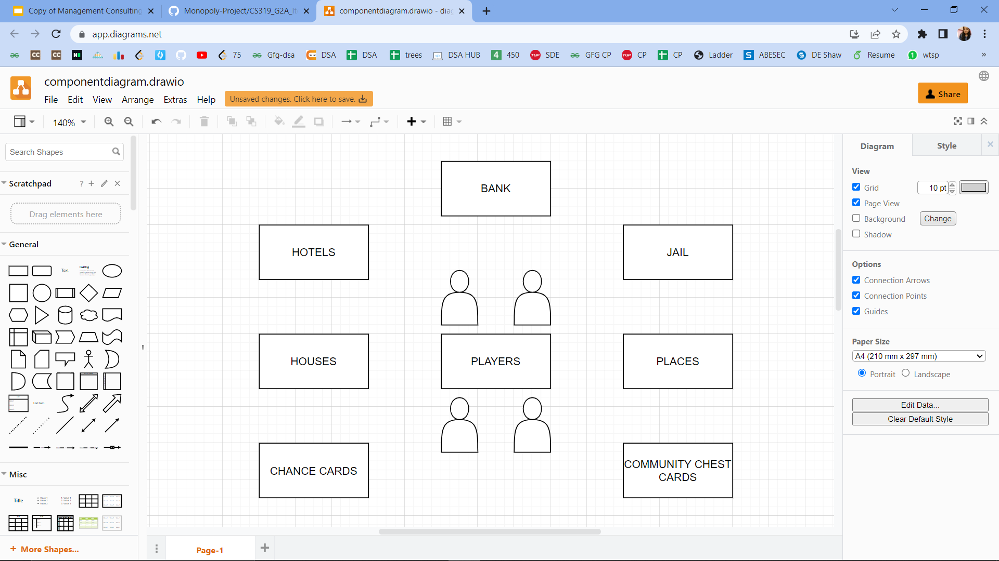
Components

Slide 9
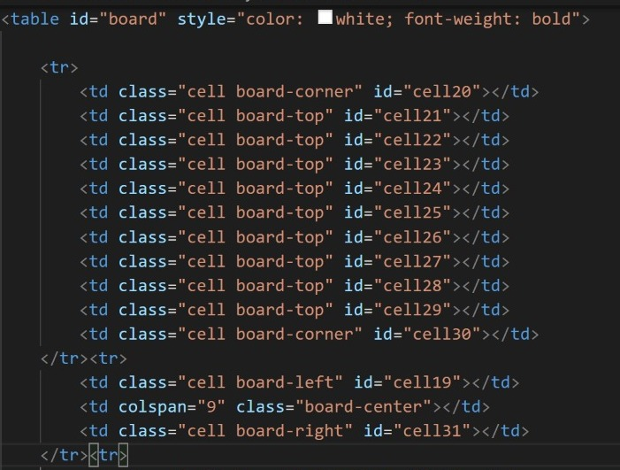
Game Board:
It is the main part of the game where players move turn by turn and build up their houses and hotels at the places they visit.

Slide 10
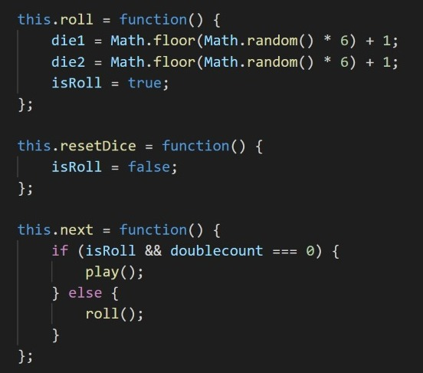
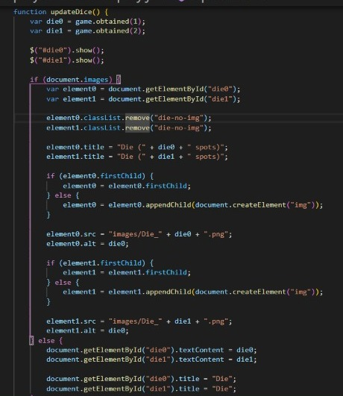
Dice:

Slide 11
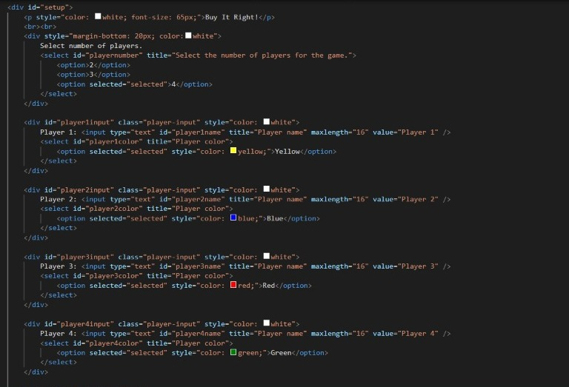
Players:
The game can be played with minimum 2 players and maximum 4 players.

Slide 12
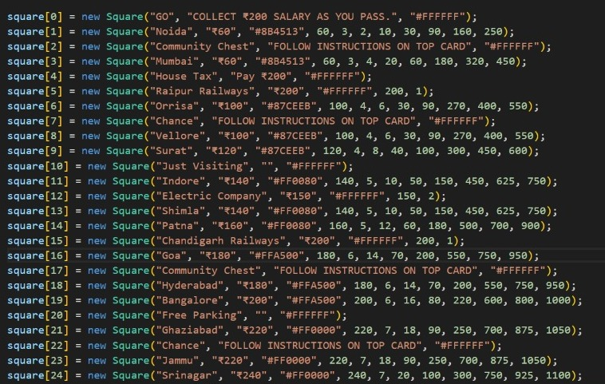
Places:
These places act as property where players may build up houses and take rent while opponent players visit their place.

Slide 13
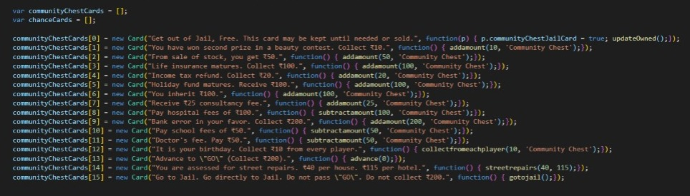
Community Chest:
Whenever a player visits this tile he’s asked to perform one the 16 tasks which turns up one by one.

Slide 14
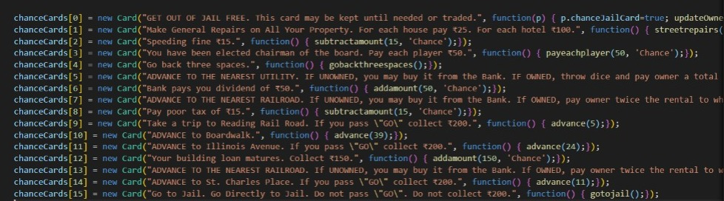
Chance Cards:
Whenever a player visits this tile he’s asked to perform one the 16 tasks which turns up one by one.

Slide 15
Design and Architecture
Buy
Unowned properties
Properties
Pass for Auction
Dice Roll
Owned properties
Game Board
Owned by others
Owned by you
Cards
Pay Rent
Manage module (Build houses and hotels)
Community Chest
Chance Card

Slide 16
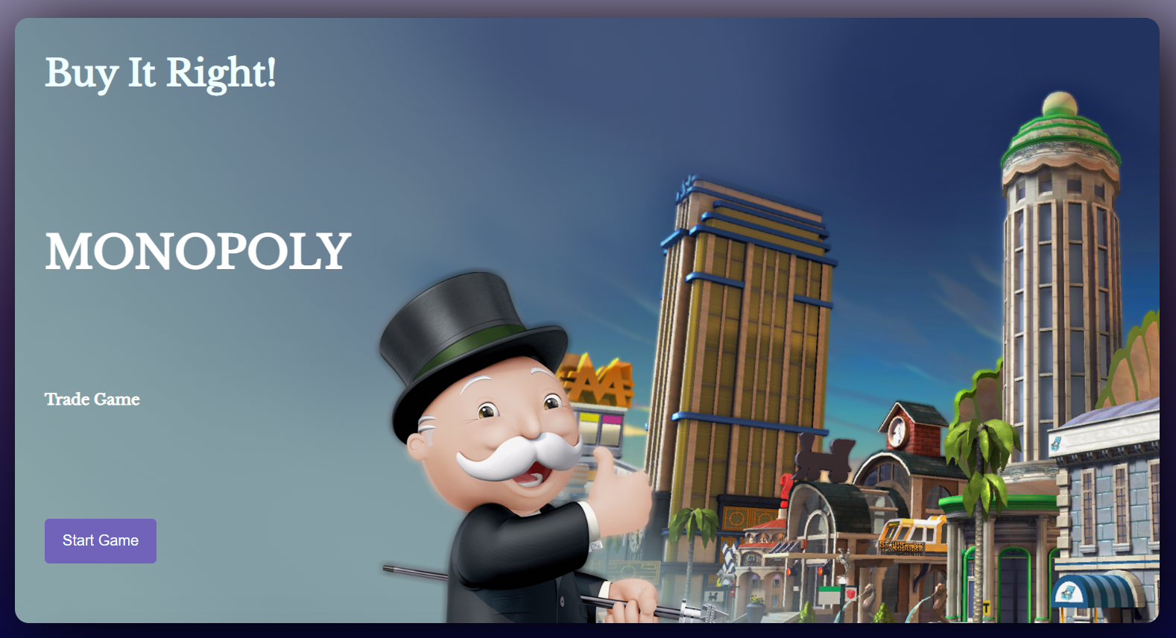
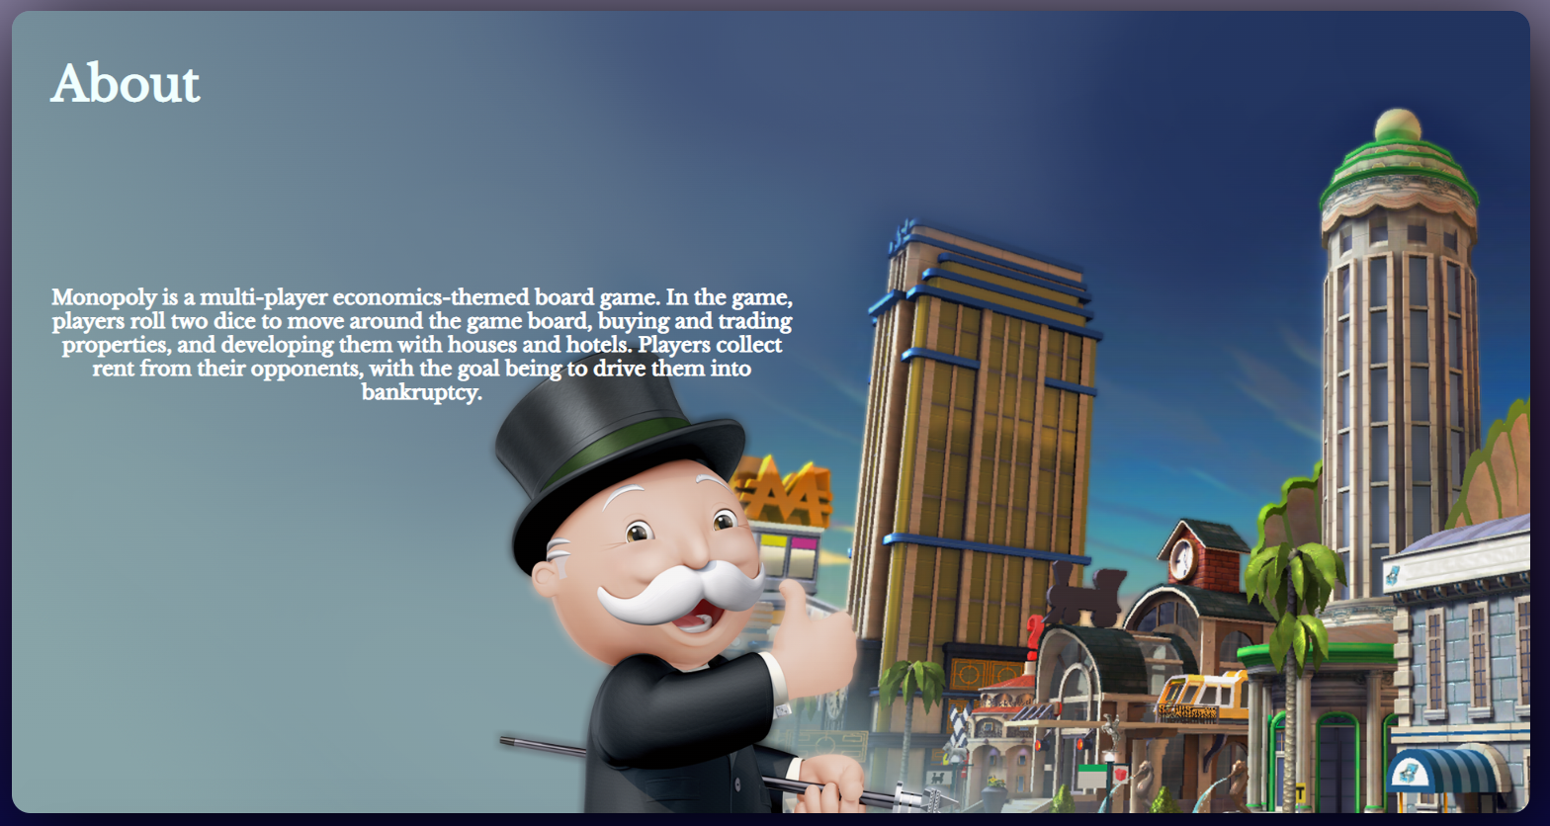
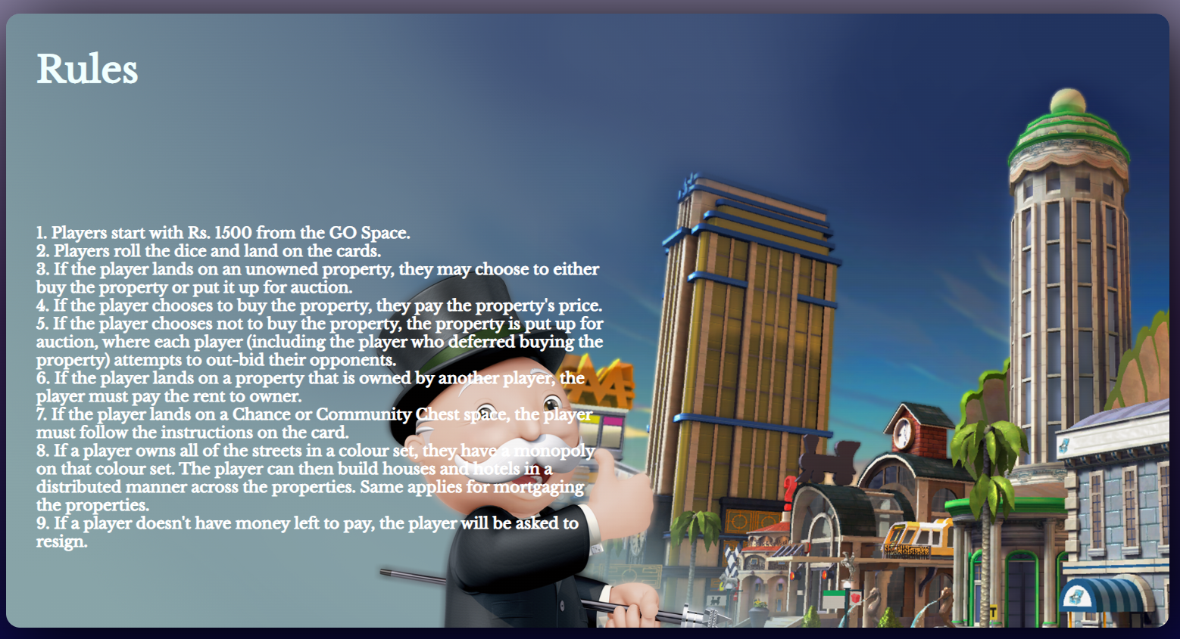
SNIPPETS FROM THE PROJECT
Home page

Slide 17
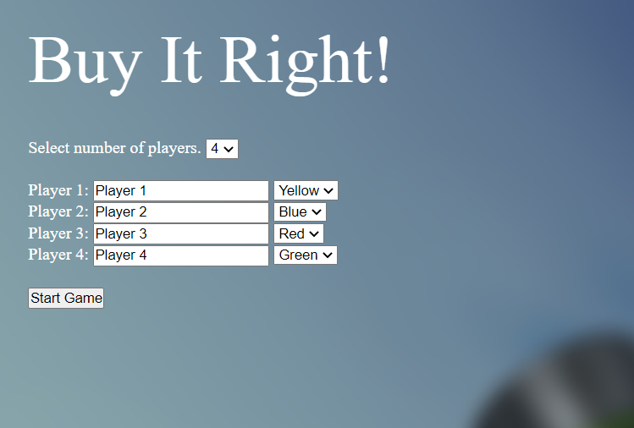
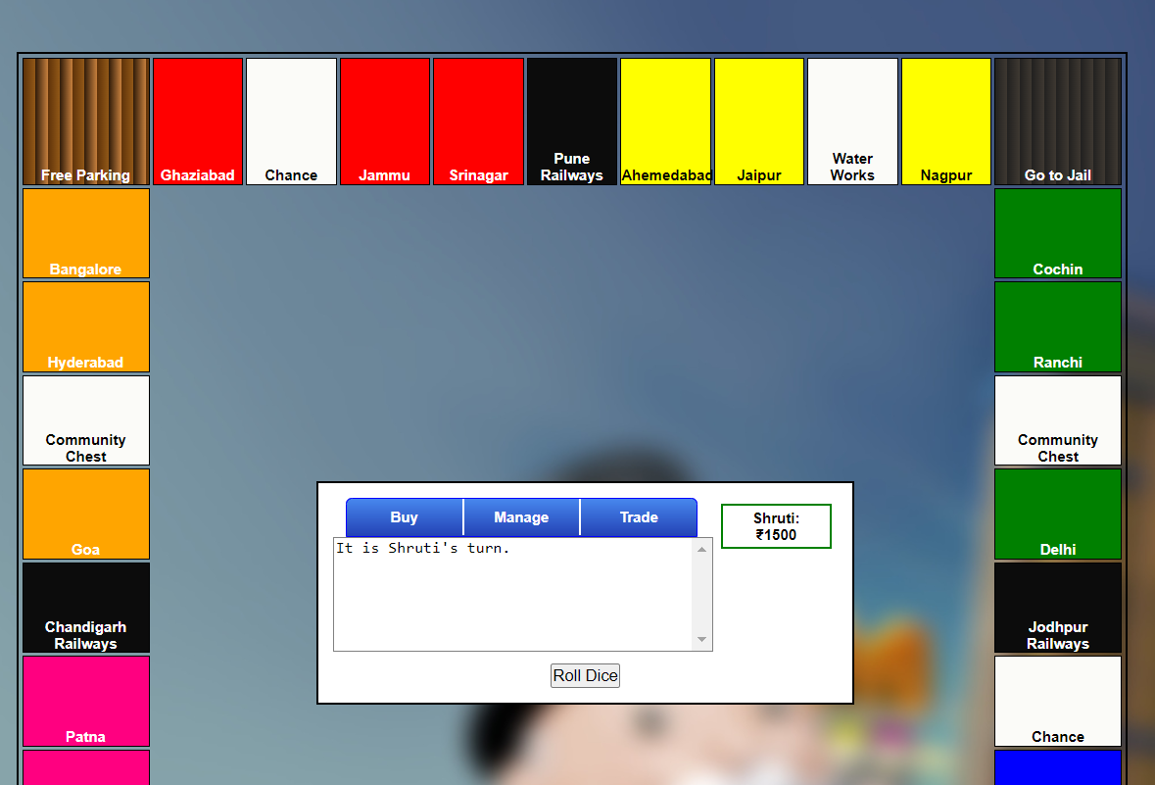
Start Page
Game Board

Slide 18
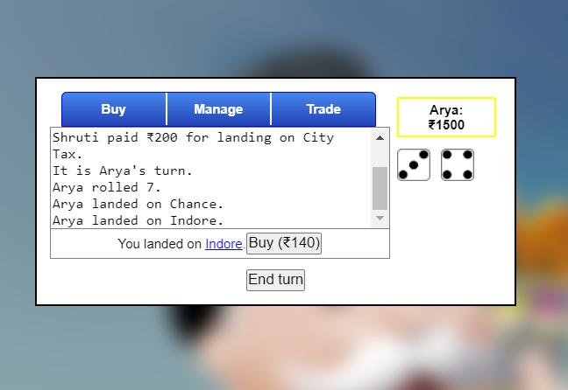
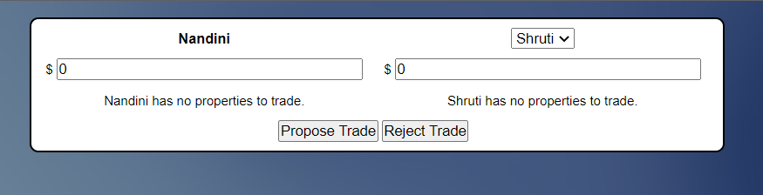
Buy Option
(allows the player to purchase unowned properties when they land on them)
Trade Option

Slide 19
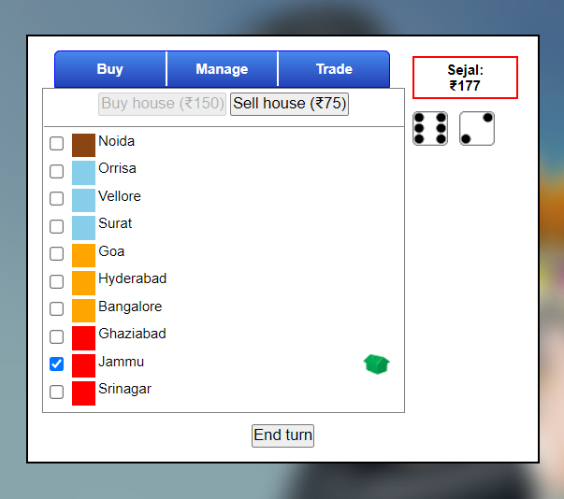
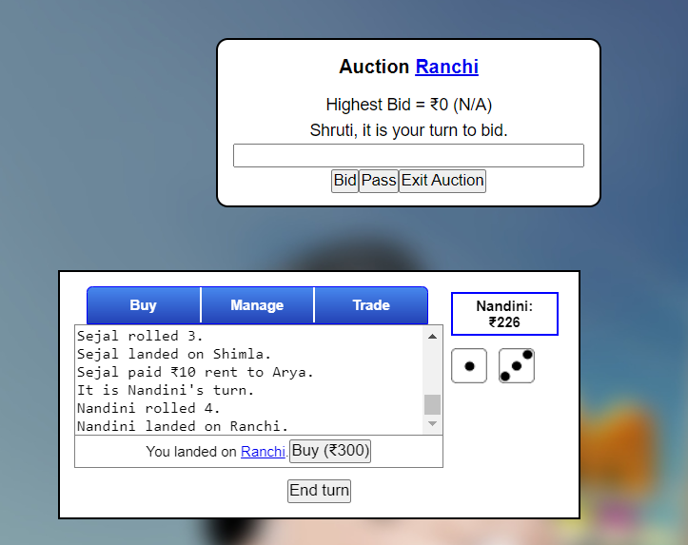
Manage function
(Allows the player to build properties of a completed set)
Auction

Slide 20
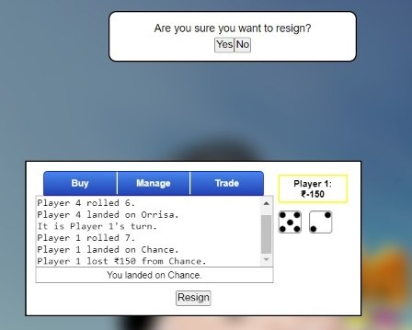
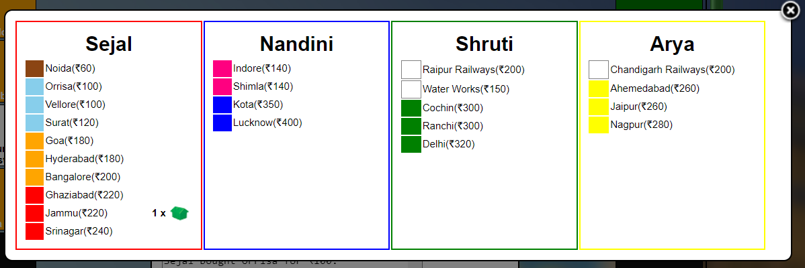
Resign View
(Bankruptcy Condition)
Asset View

Slide 21
PROJECT RESULT
Successful Completion
A fully functional Monopoly game website has been developed.
Great Learning
Efficient Collaboration
Used several concepts learnt during the various courses taught throughout this DESIS Ascend Educare program such as - Version control using Git, OOPs, Problem solving, and Presentation skills.
Successfully collaborated on a tech project and inspired each other throughout the journey

Slide 22
UI
AI MODULE
EQUITY
SOFTWARE TESTING
Allows users to hold equity in other users' properties through a mutually agreeable trade. This will help users to form temporary alliances to eliminate other players.
This module will track the state of the game as well as movement of players and provide suggestions regarding investment, buying, bidding, etc. It will involve the concept of machine learning and will be offered as a paid feature.
Further enhancements to incorporate animations such as dice rolling, player movement, etc. along with allowing players to choose custom avatars.
Performing thorough unit and integration testing on the game by writing the respective test cases.
FUTURE SCOPE

Slide 23
THANK YOU

